Slide 1

Bayesian Analysis of Sleep Data ISYE 6420 Project
Chitwan Kaudan

Slide 2
Problem Statement
Figure1: FitBit Mobile Dashboards
Mobile dashboard in FitBit app is inflexible and doesn’t allow me to compare activities over time
I want to answer the following questions…
1
What’s the probability that I sleep by 1:00 AM? Wake by 9:00AM?
What factors affect sleep duration and sleep quality?
2

Slide 3
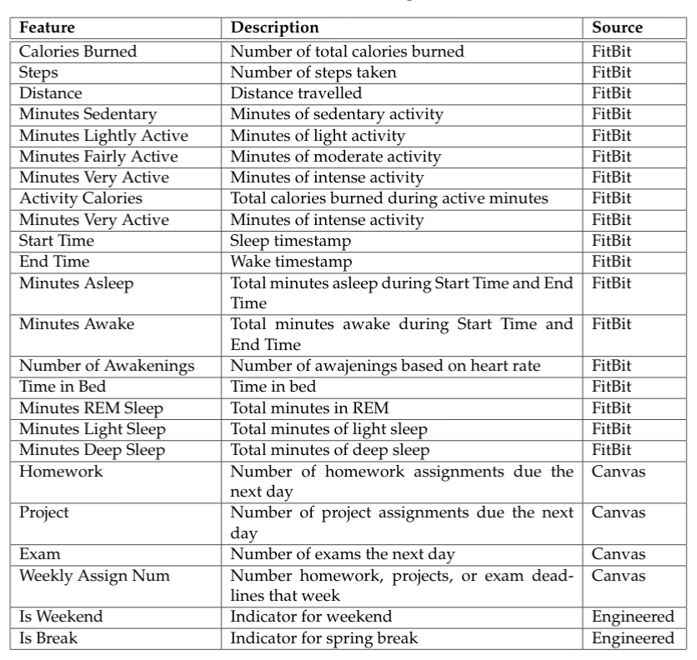
Data Collection
Table 1: Description of all features
Table 1 contains all features in my final datasets
FitBit export 2/1/2020-4/15/2020
Activity data (pink)
Sleep data (green)
Canvas export Spring 2020
Assignment deadline data (gray)
Engineered features (white)
Merged data on Date
45 data points and 24 features

Slide 4
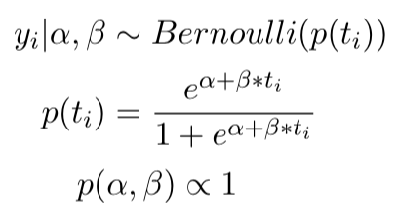
Sleep and Wake Time Analysis Approach
Created sleep time indicator dataset by enumerating each minute between 12:00AM-4:00AM each day and added asleep indicator
Identical process for wake time indicator dataset except from 6:00AM-12:00PM
Used a logistic regression model with time offset as predictor and asleep indicator as response; used uninformative prior
Generated 10K samples using adaptMCMC
Equation 1: Models for sleep time and wake time analysis

Slide 5
Figure 2: Wake time posterior distributions
Figure 3: Sleep time posterior distributions
Acceptance rate: 35.2%
Effective size for alpha: 1166
Effective size for beta: 1154
Acceptance rate: 34.9%
Effective size for alpha: 1062
Effective size for beta: 1045

Slide 6
What’s the probabilities to sleeping and waking up on time?
1

Slide 7
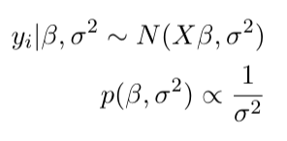
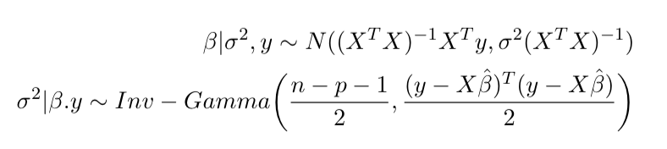
Sleep Duration and Quality Analysis Approach
Used a regression models with unknown sigma and uninformative prior
Duration Model
Response: Minutes Asleep
Predictors: All non-sleep features
Quality Model
Response: Minutes Asleep/Time in Bed
Predictors: All non-sleep features
Generated 10K MC samples
Dropped features with VIF > 20 to handle multicollinearity
Added a Minutes Sedentary squared variables
Equation 2: Models for sleep duration and quality analysis
Equation 3: Conditional distributions for MC sampling

Slide 8
What factors affect sleep duration?
2A
Features significant at 0.05 significance level:
Minutes Sedentary and Minutes Sedentary Squared
Minutes Lightly Active
Weekly Assign Number
Intercept
Notes:
- 95% Equal Tail Credible Intervals -> if 0 fall within CI, insignificant; otherwise significant

Slide 9
What factors affect sleep quality?
2B
Features significant at 0.05 significance level:
Weekly Assign Number
Is Break
Intercept

Slide 10
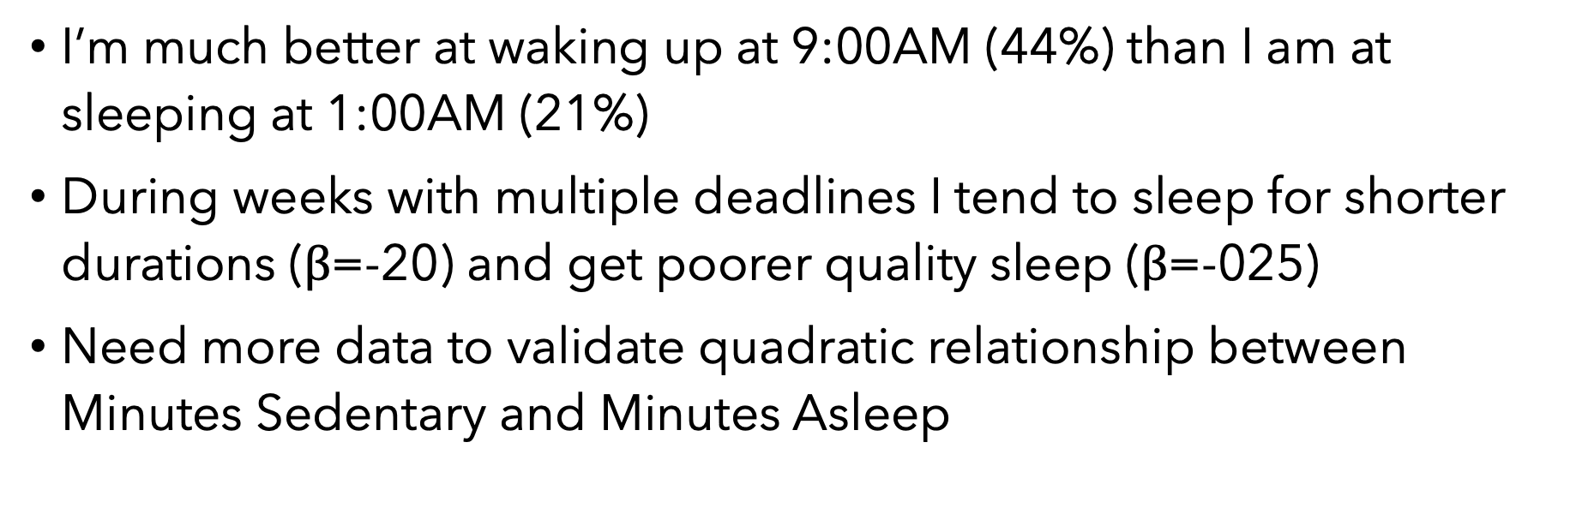
Conclusion
I’m much better at waking up at 9:00AM (44%) than I am at sleeping at 1:00AM (21%)
During weeks with multiple deadlines I tend to sleep for shorter durations ($β$=-20) and get poorer quality sleep ($β$=-025)
Need more data to validate quadratic relationship between Minutes Sedentary and Minutes Asleep

Slide 11
Thank you!

